Slide 1
Student Records System
- Hamiz Khan -
- Shazim Khanzada
-Obafemi Alli
- Patrick ReagaN
- Shubham Keshri

Slide 2
Phases
Phase 1: Systems Request Definition, System Request
Phase 2: Feasibility Analysis Executive Summary, Cost Benefits Analysis
Phase 3: Use Case Diagram, Use Case Description, Activity Diagram
Phase 4: Class Diagram, CRC Cards, UML Diagram
Phase 5: Sequence Diagram, Communication Diagram, Object State Diagram
Phase 6: Package Diagram
Phase 7: HCI Layer, PD Layer, DM Layer, Map Problem Domain
Phase 8: Windows Navigation Diagram, Deployment Diagram, Test Plan, Converstion Strategy, Post-Implementation Activities, Sample User Interface

Slide 3
Phase 1
Systems Request & Systems request definition

Slide 4
Phase 1
System Request – Student Record System Project
Project sponsor: School of Prosperity
Business Need: Initiated to establish an online system for class registration and student academic records
Business Requirements:
The functionality that the system should have is listed below:
Maintain records for the following:
Students enrolled
Courses offered
Classes offered
If the classes are online or face-to-face
Students grades for the classes they have completed
Be internet accessible
Allows students to self-register for their own classes
Allow staff to work from any location that has an internet connection and a web browser.

Slide 5
Phase 1
Business Value:
Our expectations for this record system is that it will improve class registration process for students due to allowing students to register for classes themselves online instead of filling out a paper form. The previous system will be replaced, which will eliminate many problems that it had, such as the longer processing times, clerical errors, and the staff experiencing work overload at the beginning of each semester. The switch to a digital system will relieve the congestion that was experienced by the staff, allowing them to perform their regularly assigned duties without the worry of student registration on top.
Conservative estimates of tangible value to the company includes:
Saving time and money from the administration staff
Saving time for students enrolling in courses
Staff development and training increases productivity and skills.
$200,000 per semester saved in overtime salary since staff will not have to stay after hours to finish enrollment
$1,000 per semester in paper
$5,000 per semester in printer ink, toner, and maintenance
$1,000 per semester from being able to close the enrollment office early, saving costs on electricity and A/C
Special Issues or Constraints:
System shutdown from increased traffic.
Completion of system is time sensitive.
Hire staff to maintain the productivity of the system.
Administrative access
Real-time updates offered from the system.

Slide 6
Phase 1
Questions:
# | Question | Who to Ask?
1. | Who has access? | Academic department supervisor, registrar’s office
2. | How many users? | Registrar’s office
3. | Time frame? | Academic department and registrar’s office
4. | Data amount? | Academic department and registrar’s office
5. | Budget? | Accounting and finance department
6. | Details of the current system and whether it can be extended. | IT Department
Explanation of work:
We completed the project as a group. We shared our ideas as we went along. We used the combination of the information given and our experiences to make the project that we thought would be best represented.

Slide 7
Phase 1
Student Records System SRS – Requirements Definitions
Non-Functional Requirements:
Operational Requirements
The system will be accessible 24 hours a day, 7 days a week
The system will be able to work on any machine processor
The system will be available to all users who attend the University.
Performance
The system will be able to operate under high traffic.
The system will be able to run swiftly at all times.
The database will be able to quickly collect and display the information to the user.
The database will update weekly.
There will be one hour a day where the system dedicates it’s time to maintenance where the user will not be able to access the system.
Security
The system will be safe from any attempts of hacking.
The system will be able to attend to viruses and malware and know how to take care of them properly.
The system will be able to store students and staff’s private information securely.
The system will keep all private information of students and users safe.

Slide 8
Phase 1
Functional Requirements (with details)
Advising Staff Interface
The system will allow staff to see which students are enrolled in each class.
The system will allow staff to access student’s GPA and classes they have already completed.
The system will allow staff to set a prerequisite for each class.
The system will allow staff to set the date and time for each class being enrolled.
The system will allow staff to limit the number of students being enrolled in each class.
Student Interface
The system will allow students to see the date and time of class.
The system will allow students to check if they qualify to be enrolled in a class.
The system will allow students to see their GPA and amount of credits they have.
They system will allow students to be entered in a waitlist.
The system will allow the students to see how many seats are left in the class being offered.
Students have an option to add or drop a class.
The students can choose whether they want to take the class online or in person.

Slide 9
Phase 1
Functional Requirements(Cont.)
Technical Support Interface
The system will allow technical support staff to change the status of the system.
The technical staff can shutdown the system at any time.
The technical staff will have a separate display that shows all the coding done for the system.
The technical staff has an option to put the system in maintenance mode.
Database Management
Store information of students and staff.
Store information of the number of seats left in a class.
Store information of the class such as who is teaching and what the class is about.
Support Management
The system will allow students to see the syllabus of the class.
The system will allow students to ask questions they have about the enrollment process.
The system will allow staff to communicate with the students if there is a change in the class being enrolled.

Slide 10
Phase 2
Feasibility Analysis Executive Summary & Cost-Benefit Analysis

Slide 11
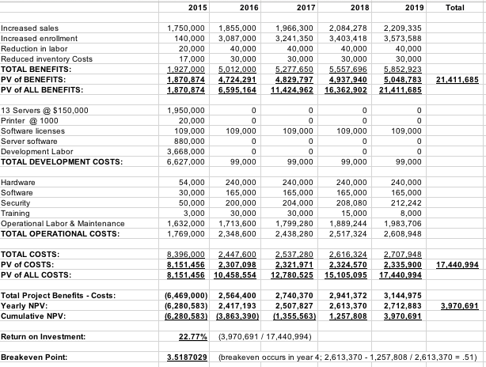
Phase 2-Feasibility Analysis Summary & Cost Benefits
Technical - Can we build it?
Familiarity - IT department maintenance
Compatibility - School has in house Application
Project Size - Larger project, more risk
Economic- Should we build it?
Cost and possible returns on Investment
Organizational -If we build it, will they come?
Does it match our school profile and need?

Slide 12
Phase 3
Use case diagram & use case description

Slide 13
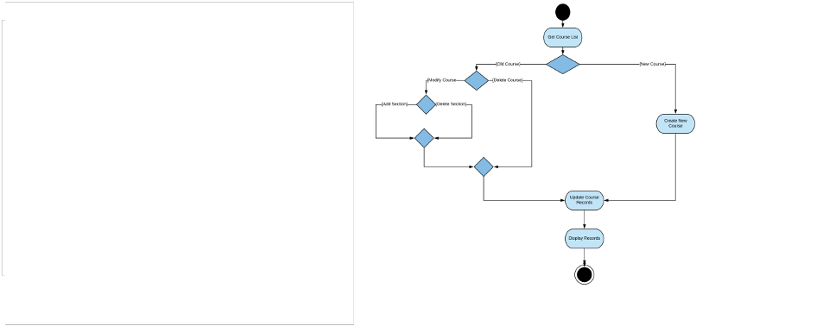
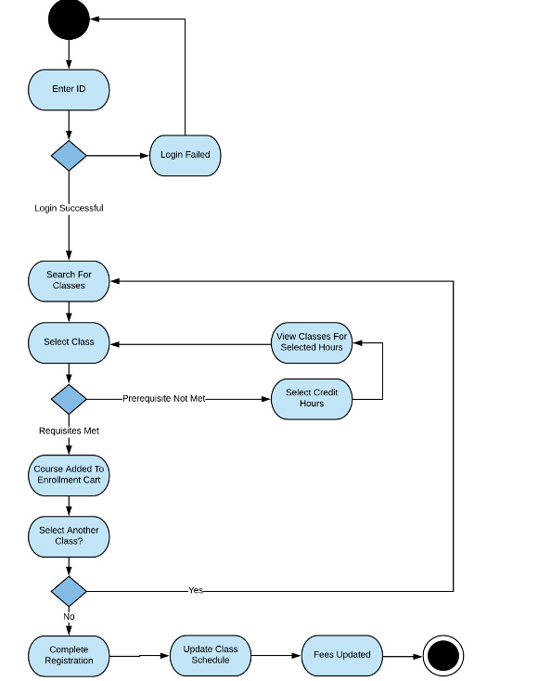
MAINTAIN COURSE RECORDS
REGISTER STUDENT FOR CLASS

Slide 14
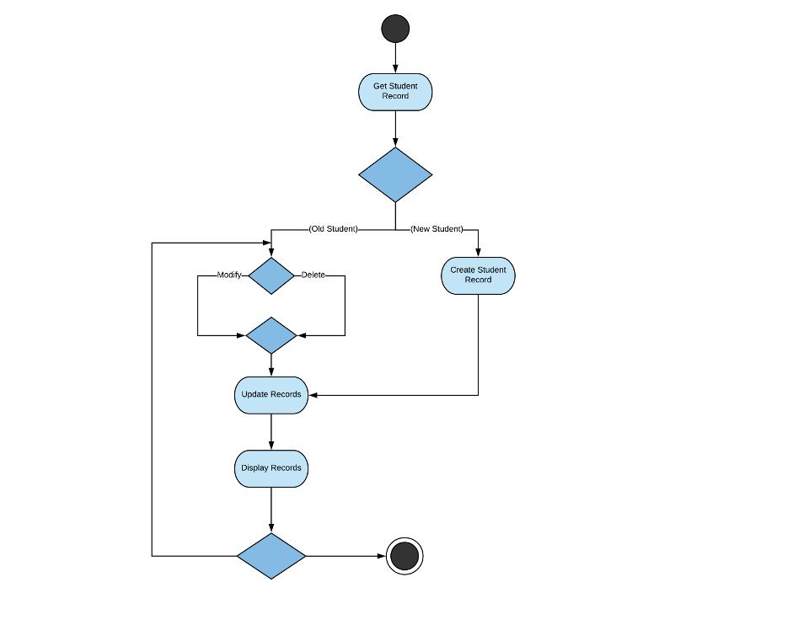
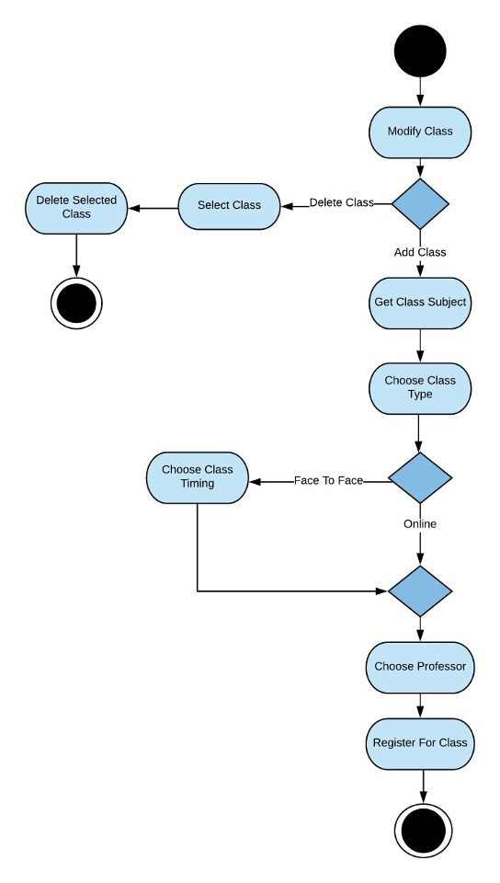
Phase 3
MAINTAIN STUDENT RECORDS
MAINTAIN CLASS RECORDS

Slide 15
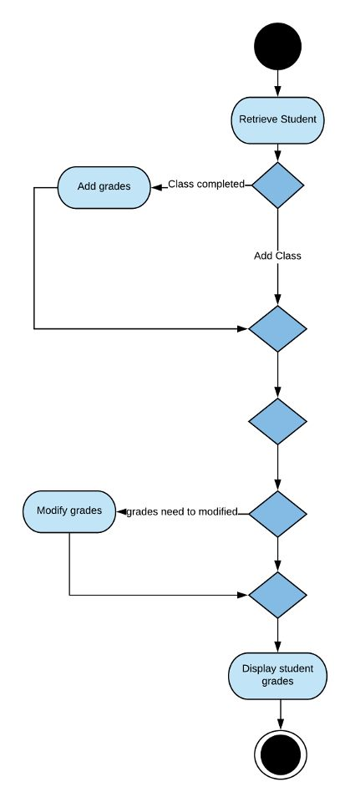
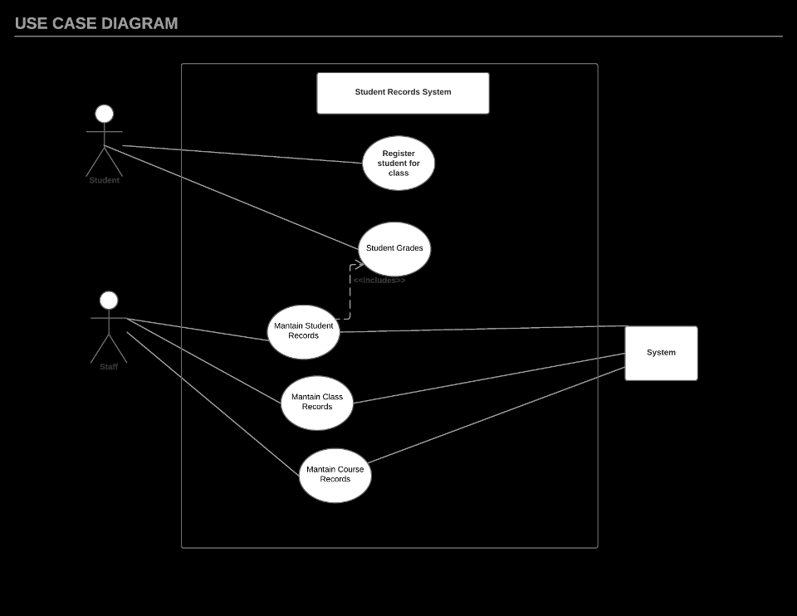
MAINTAIN GRADES
USE CASE DIAGRAM

Slide 16
Phase 3
Use Case Name: Maintain Student Records | ID: 1 | Importance Level: High
Primary Actor: Student | Use Case Type: Essential, Detailed
Stakeholders and Interests: 1.Students who want to make changes to their record. 2.Administrative staff that wishes to retrieve student records. 3.Our new system should update and maintain student records once a student makes a change to their information.
Brief Description: This use case describes how student records are maintained.
Trigger: A student trying to make changes to their information. Type: External
Relationships: Association: Student request system and Administrative staff. Include: Student grades. Exclude: Generalization:
Normal Flow of Events: The student records are displayed. If the student doesn’t exist, then a new student record is made. If a student exists, then there is an option to modify or delete a student. After a decision is made the student records are displayed. There is an option to go back to either modify or delete a student.
SubFlows: -
Alternate/Exceptional Flows: If a student doesn’t exist, then a new record is created.
Use Case Description

Slide 17
Phase 4
CRC Cards, Class UML diagram & Class Diagram

Slide 18
CRC Cards
CRC Cards document the responsibilities and collaborations of a class.
They are a low tech, hands on, and user friendly way of showing the classes and their information.
They allow us to capture all the relevant information and put them in a practical approach for quick access

Slide 19
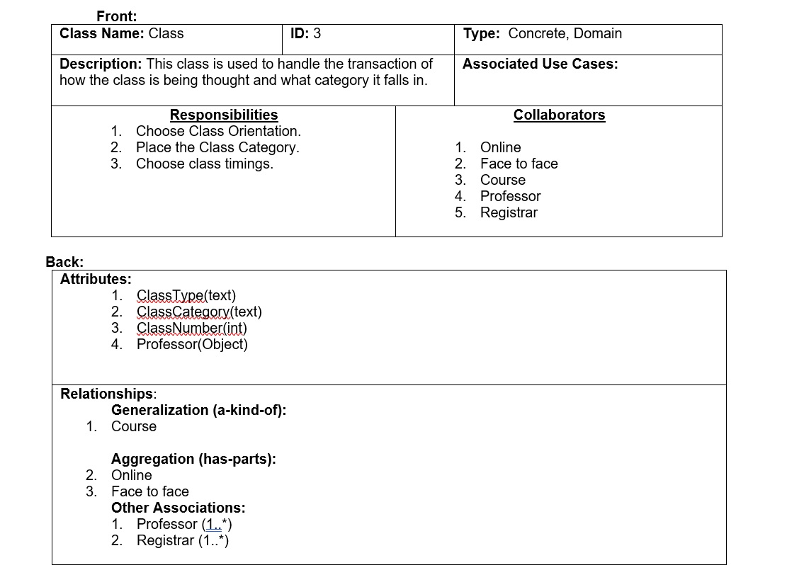
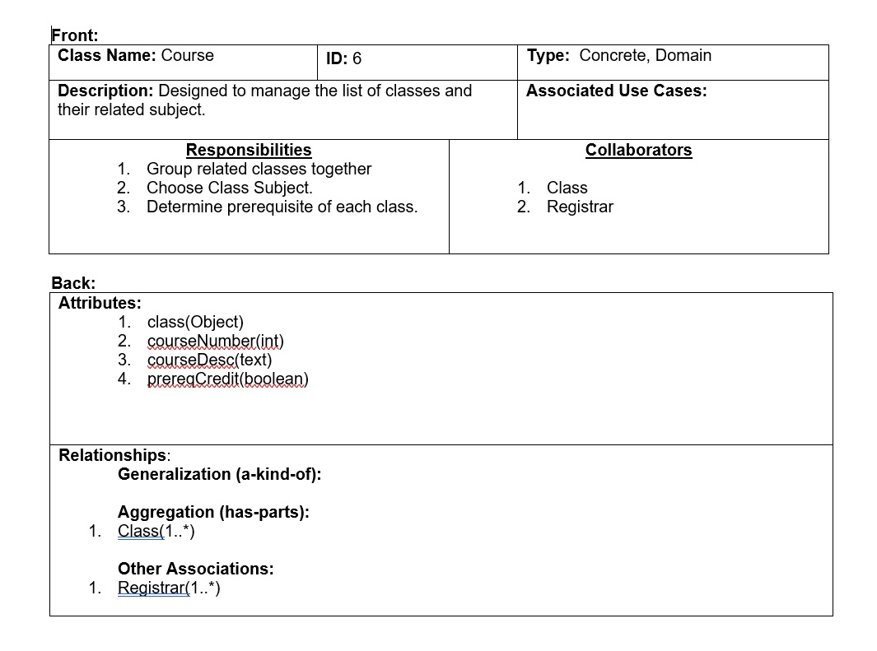
CRC CLASS
CRC COURSE

Slide 20
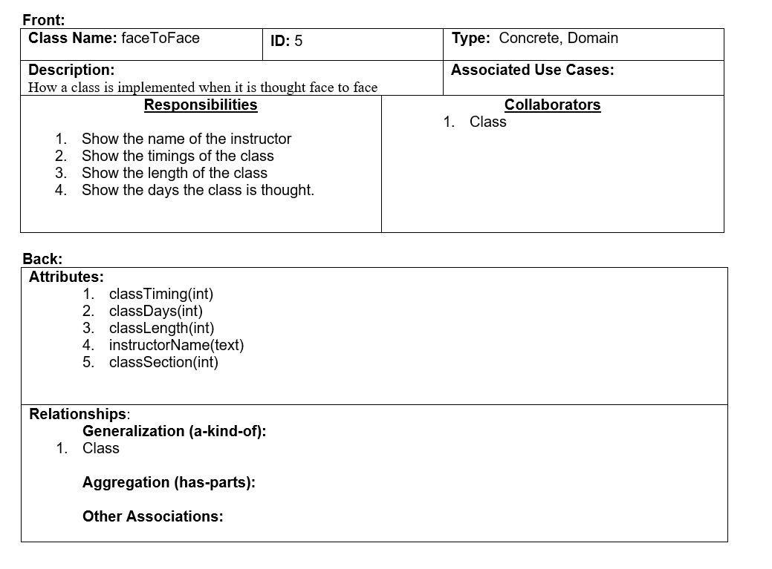
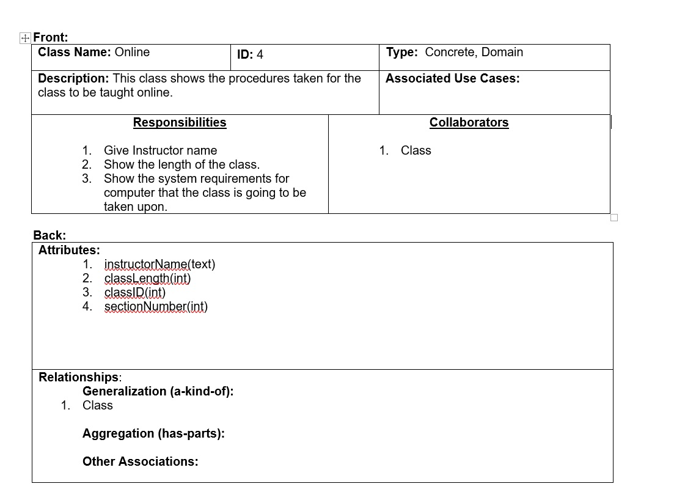
CRC FACE
TO FACE
CRC ONLINE

Slide 21
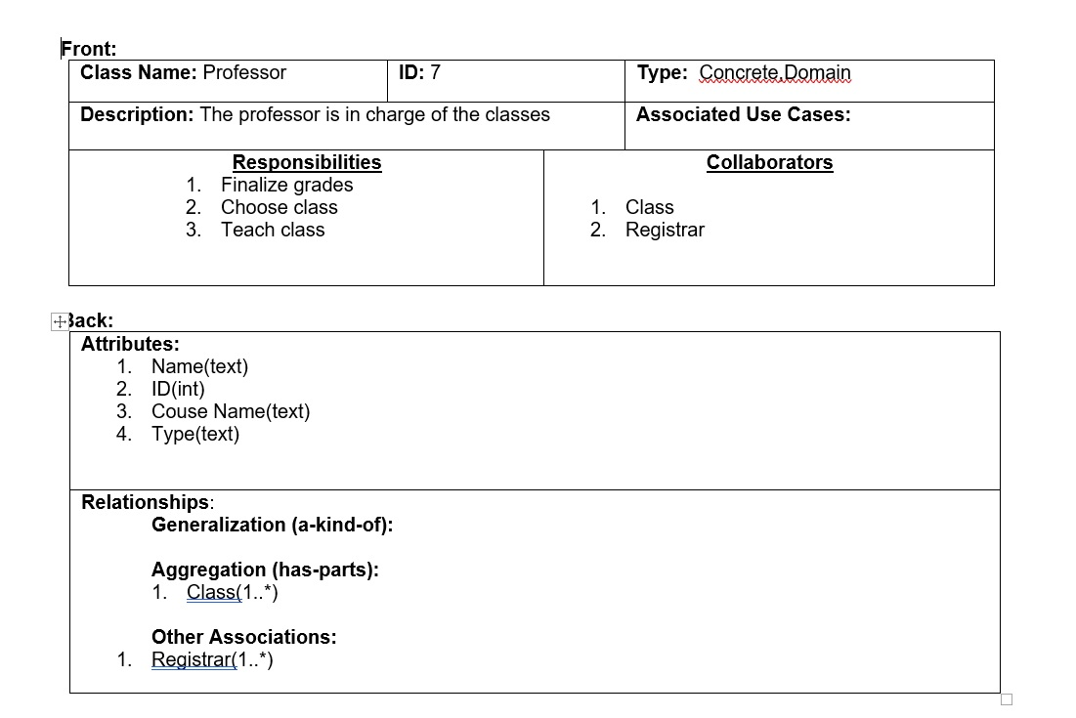
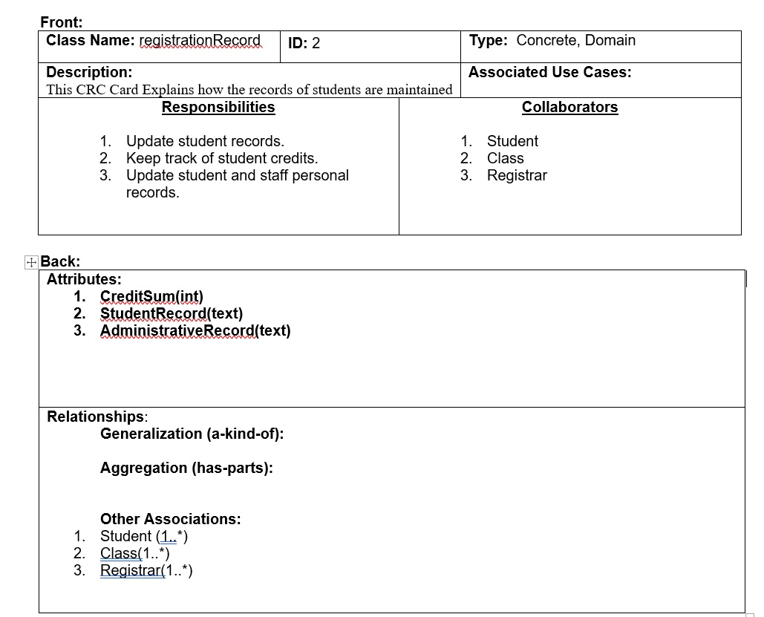
CRC
REGISTRATION
RECORD
CRC
PROFESSOR

Slide 22
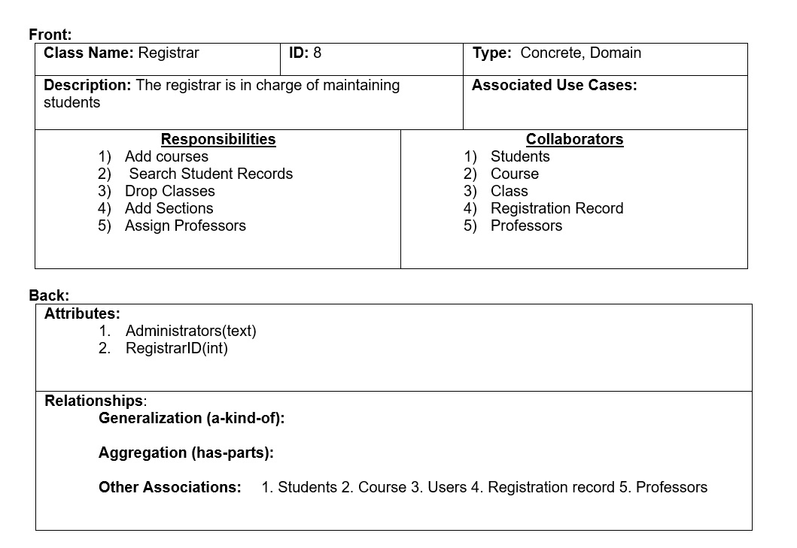
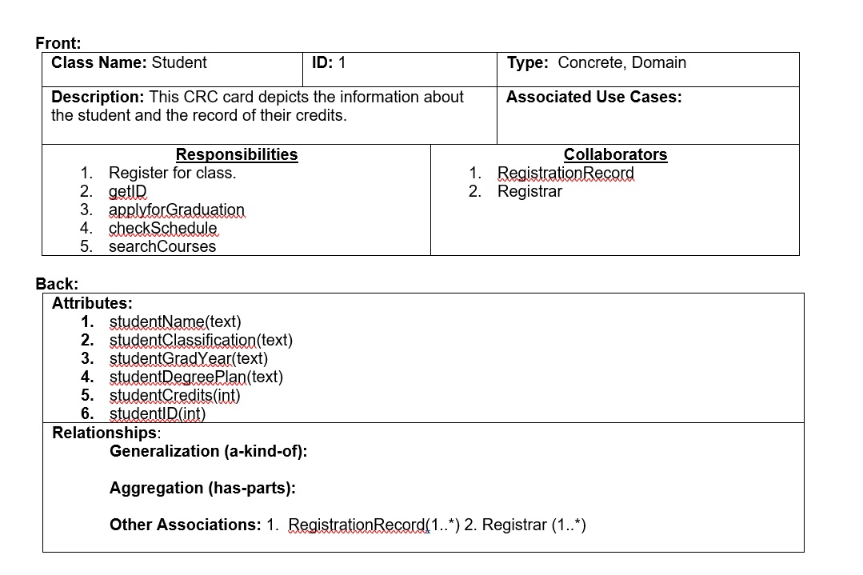
CRC
REGISTRAR
CRC
STUDENT

Slide 23

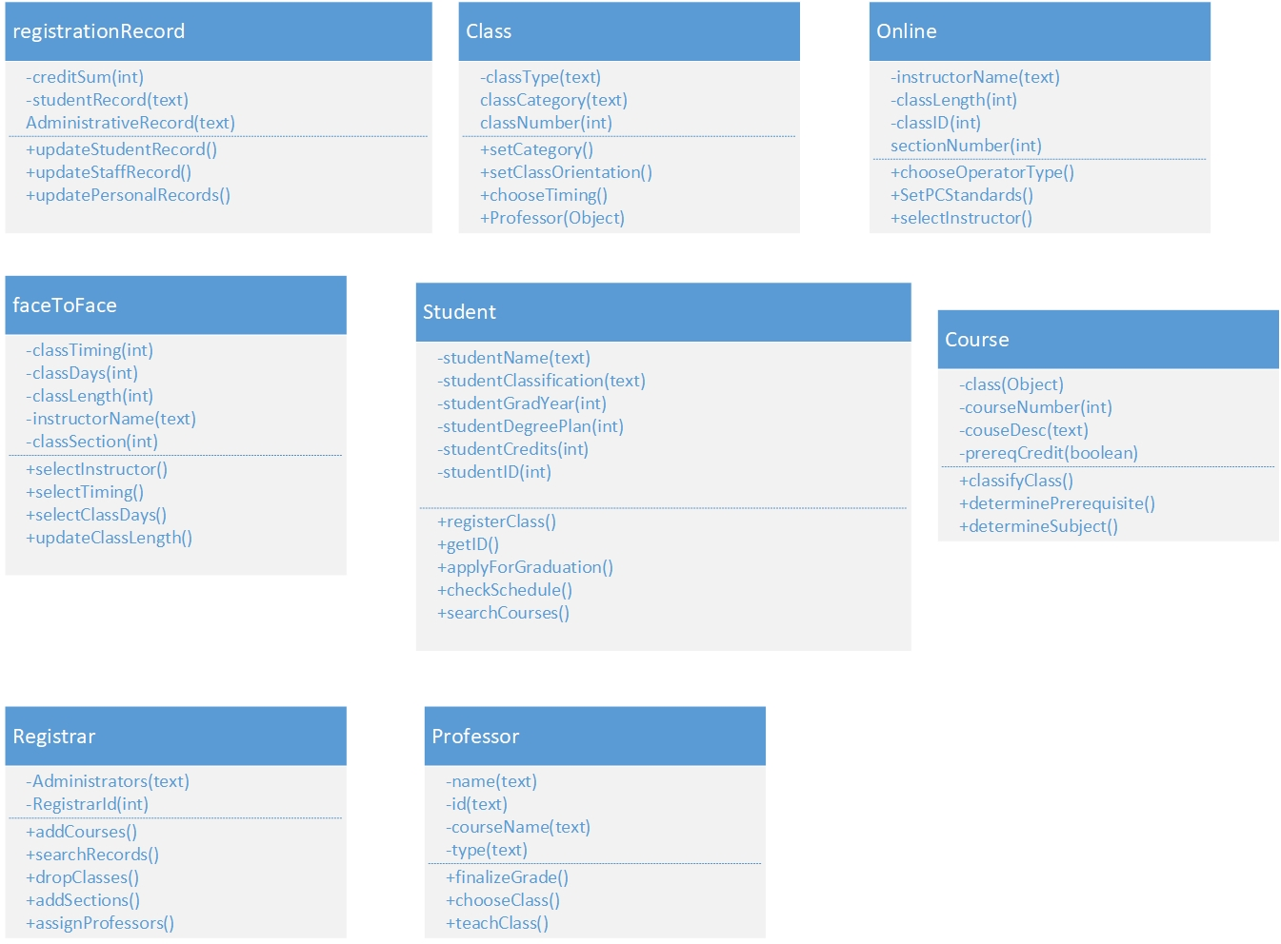



UML DIAGRAM
UML diagrams provide a simple way of visualizing the system.
They are intended to quickly look at the attributes and methods of a class.
Here we show all the UML diagrams we have used for our system.

Slide 24
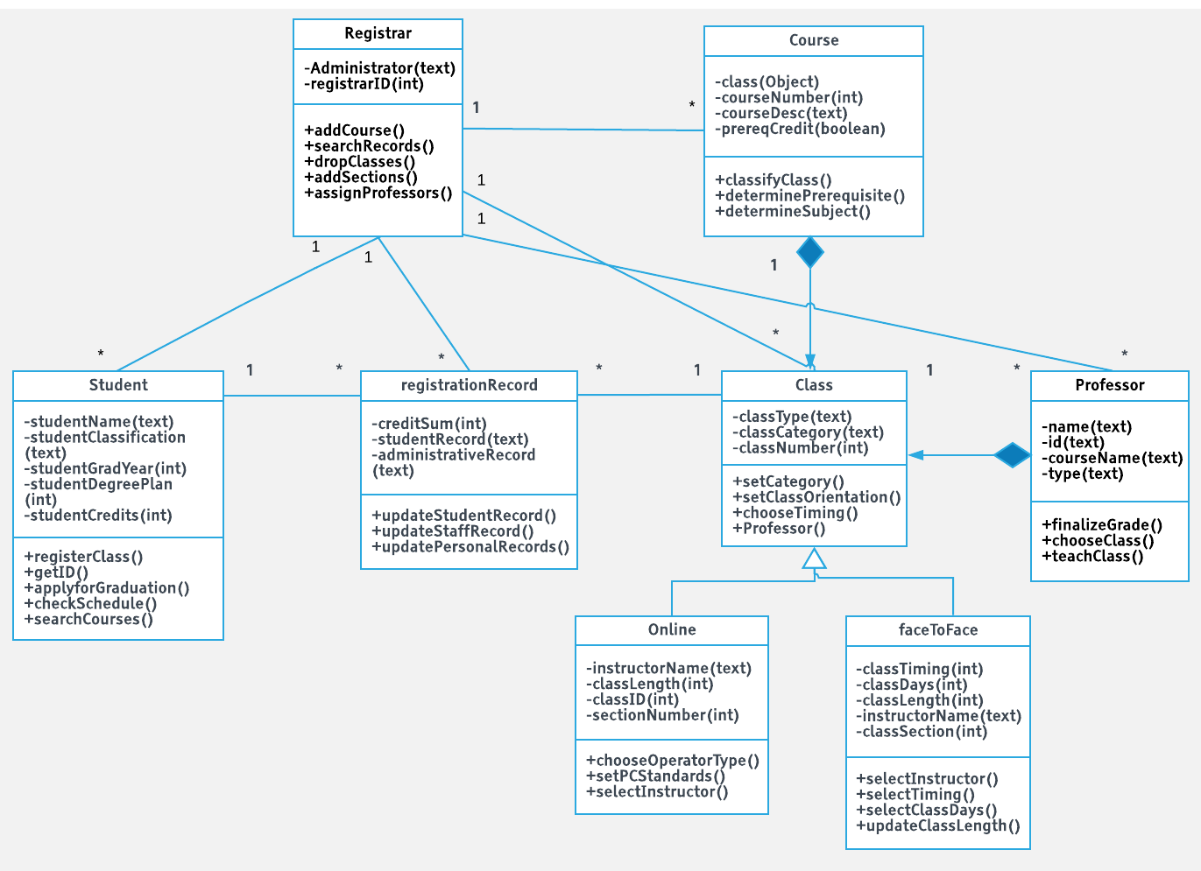
CLASS DIAGRAM
Class diagrams show the inter-relationships among the classes.
It is a unique and quick way of looking at the correlation for the classes.
In our system we have 1..* associations and Composition relationships between Class, Course, and Professor.
Class cannot exist without Course and Class cannot exist without Professor.
We also have a generalization between online, face to face, and class.

Slide 25
Phase 5
Sequence, communication, and object state diagrams

Slide 26
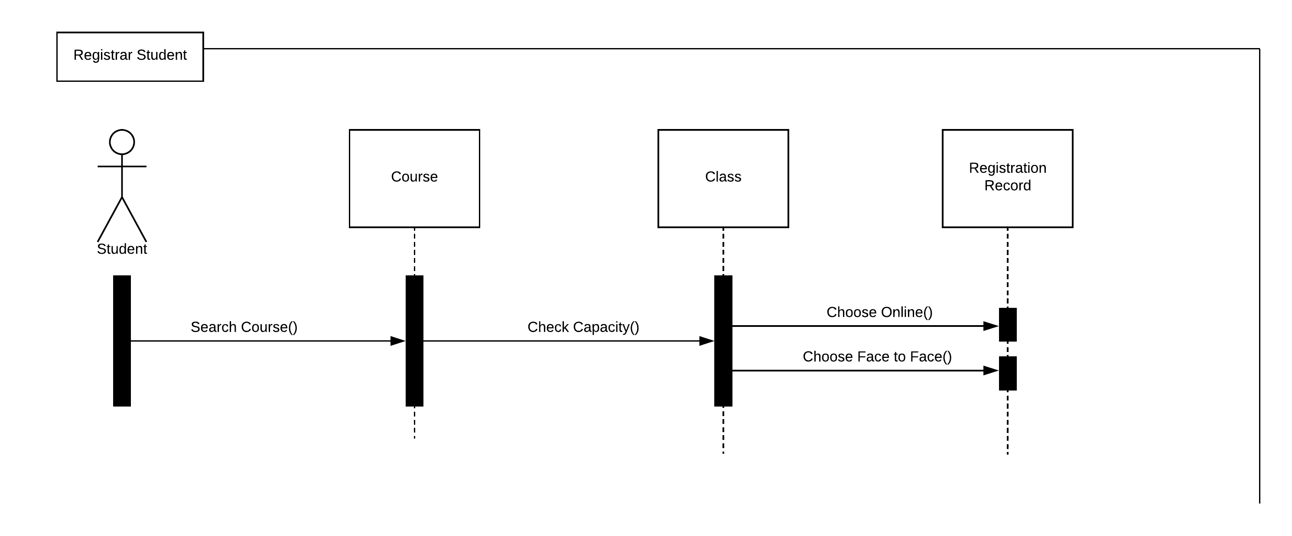
SEQUENCE DIAGRAM
A sequence diagram is an interaction diagram that shows how objects operate with one another and in what order.
In this diagram we have a student who searches for a course and chooses a class he wants to choose. The student has the option to either do it online or do it face to face.

Slide 27
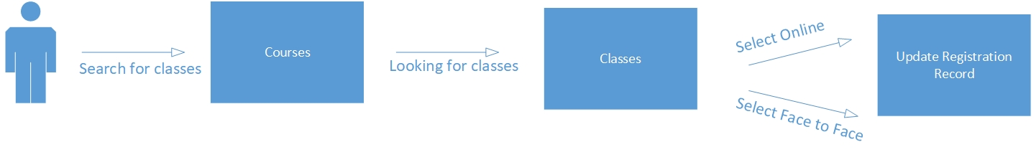
COMMUNICATION DIAGRAM
Communication diagrams are a kind of a UML interaction diagram that show interactions between objects and/or parts using sequenced messages in a free-form arrangement.

Slide 28
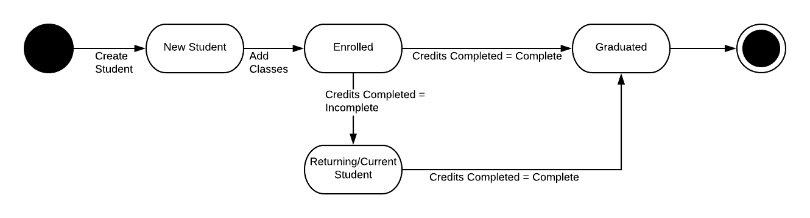
OBJECT STATE DIAGRAM
Object state diagrams describe the state of the object and how objects may change state in response to an event.

Slide 29
Phase 6
Package Diagram

Slide 30
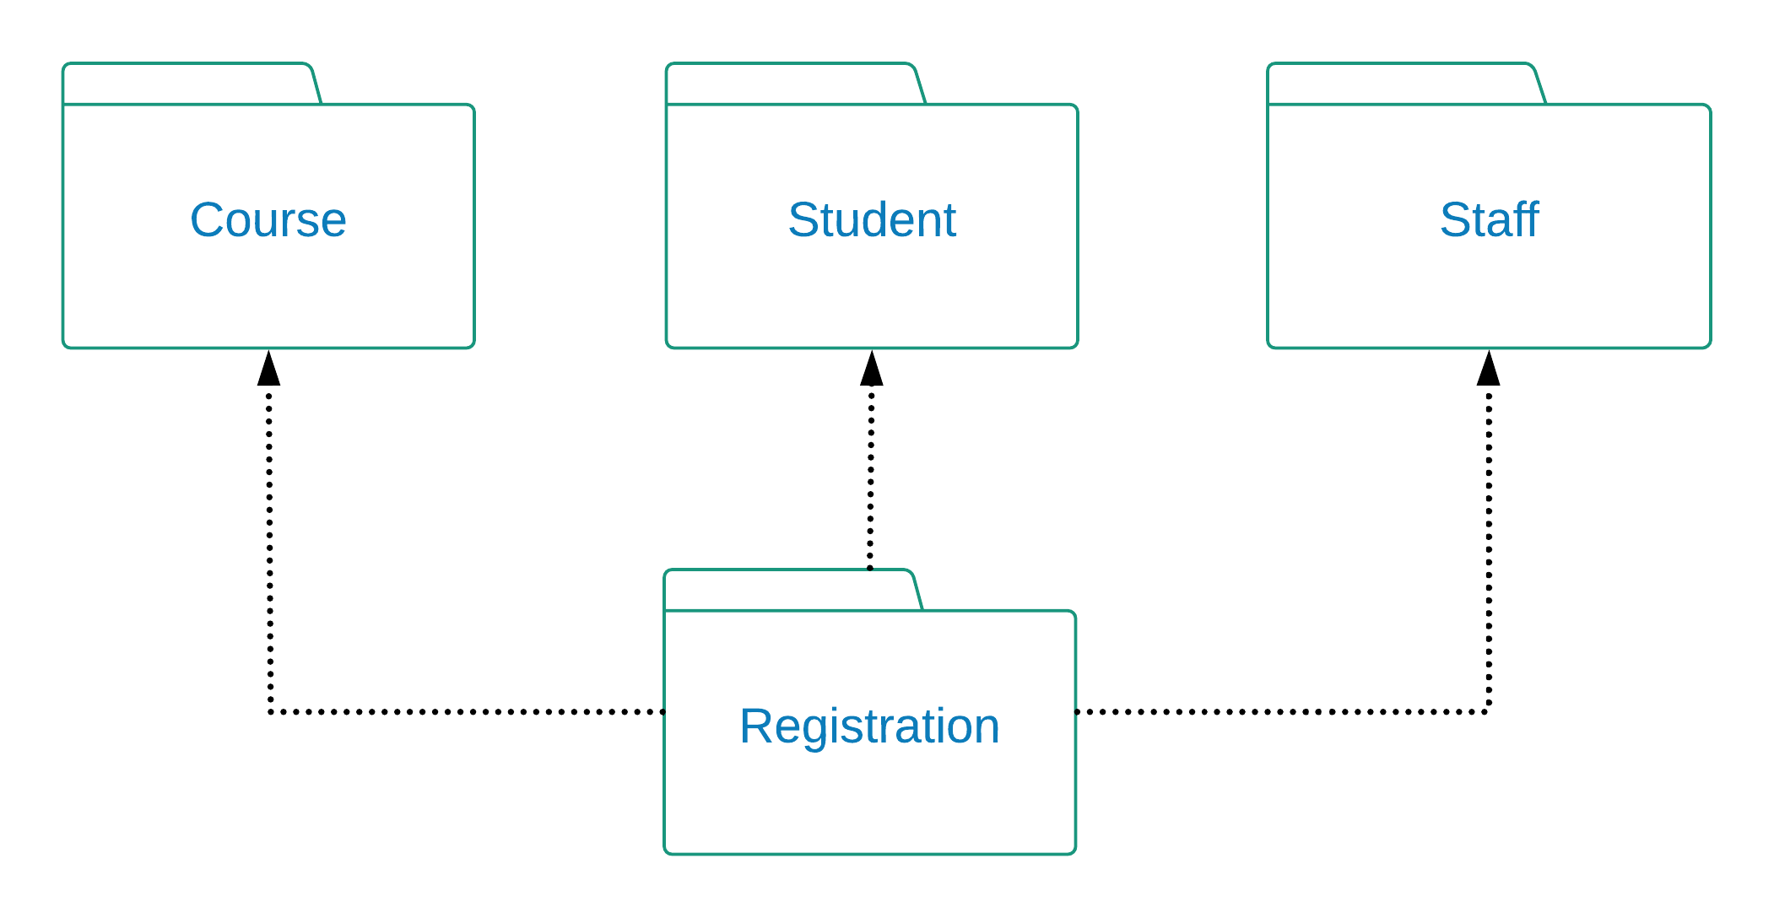
Package Diagram
A package diagram depicts dependency relationships between packages
The arrows point to which package each is dependent on

Slide 31
Phase 7
Mapping & layers

Slide 32
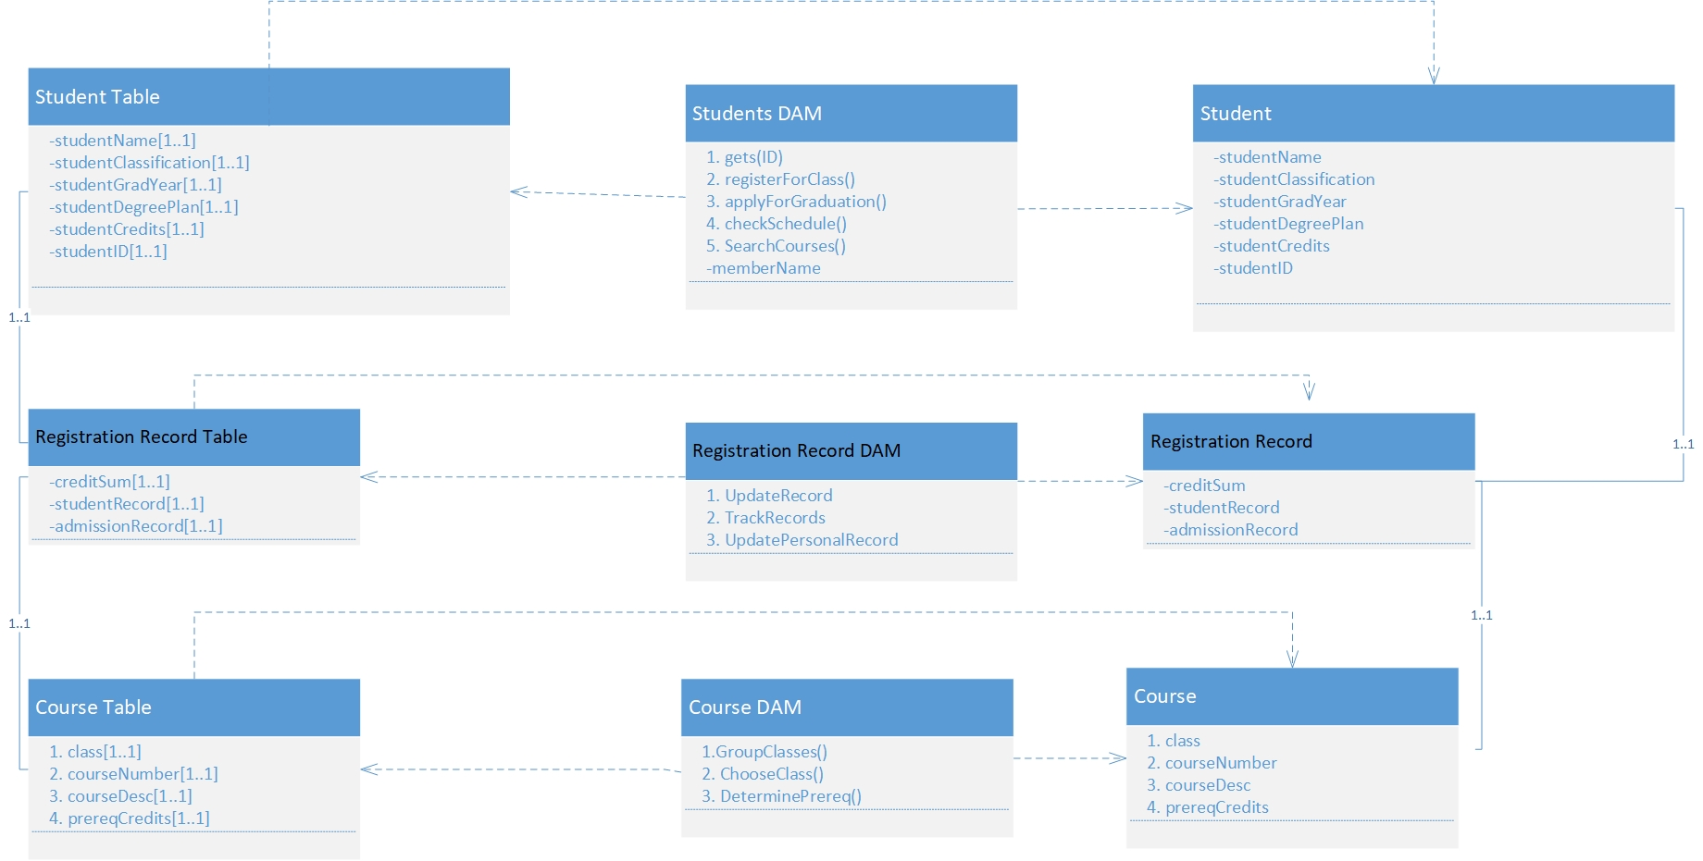
MAPPING
Mapping is used to map the different layers together. From the UI to the concrete classes and the instantiation of the concrete class is saved to the database as an object.

Slide 33
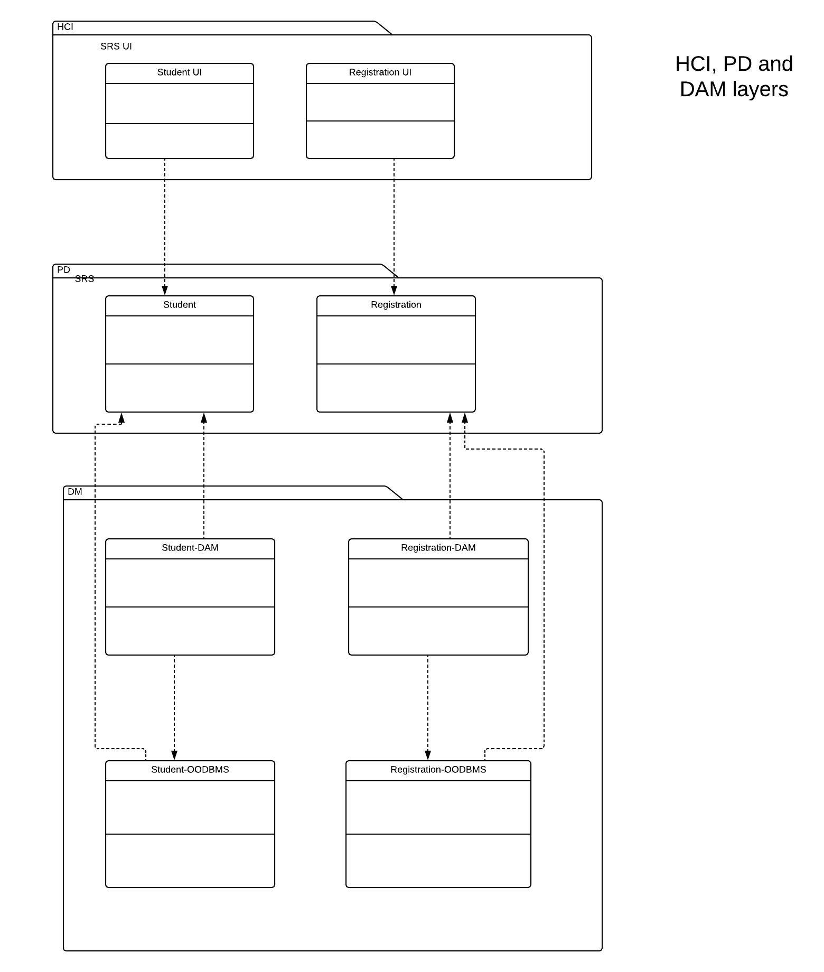
HCI, PD, & DAM LAYERS
PD Layer
The Problem Domain layer is for general classes in our everyday needs such as a Date class.
DAM Layer
The DAM layer is for database objects to store data
HCI Layer
The HCI Layer is for visual aspects for the user to see. It involves the uses of containers, and GUI type material.

Slide 34
Phase 8
Windows navigation diagram, Deployment diagram, Test plan, Conversion strategy, Post-implementation activities, Sample UI

Slide 35
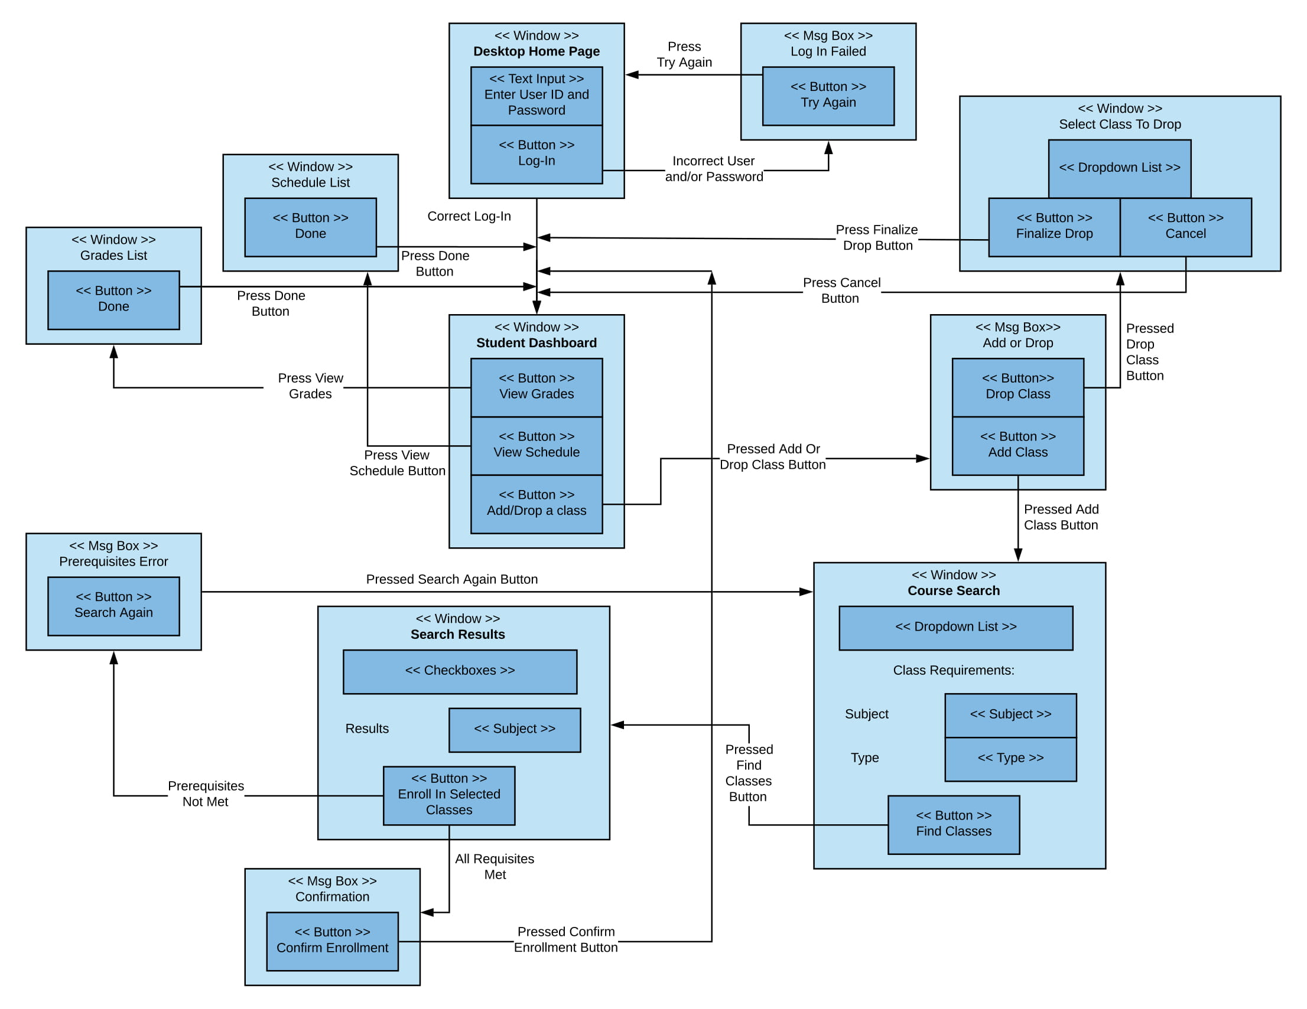
WINDOWS NAVIGATION DIAGRAM
Shows how screens, forms, and reports used by the system are related
Shows how a student using the website will navigate through the different webpages

Slide 36
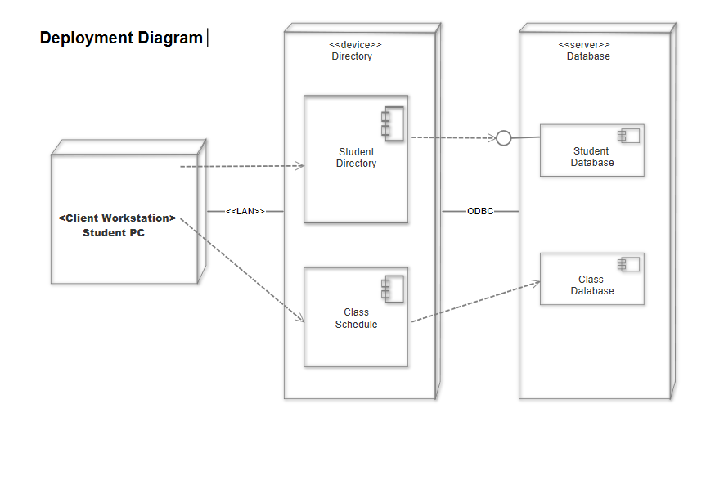
DEPLOYMENT DIAGRAM
Deployment diagrams show the relationships between the hardware and the infrastructure.
They enable us the represent how the systems communicate with the software in the environment from the execution of the software.

Slide 37
Conversion Strategy
Parallel Conversion
Utilize the current system as a backup in case of any unforeseen problems.
Simultaneous Conversion
The system was made ready to all users at the same time.
Whole System Conversion
The whole system was be converted and installed at the same time.

Slide 38
Test Plan
Unit Testing:
Black Box Testing
Integration Testing:
Focus on Use-Case Testing, Interaction Testing
System Testing:
Focus on Requirements Testing, Usability Testing, Performance Testing, and Security Testing.
Acceptance Testing:
Beta Testing.

Slide 39
Post-implementation Activities
System Support:
Transition to the operating group
Online Support with FAQs.
Help Desk: Level 1 support & Level 2 support.

Slide 40
Post-Implementation Activities
System Maintenance:
Monthly system maintenance Sunday morning @ 2:00 am.
Maintenance after each semester to check the system.
Change requests.
Project Assessment including Team and System Review.

Slide 41

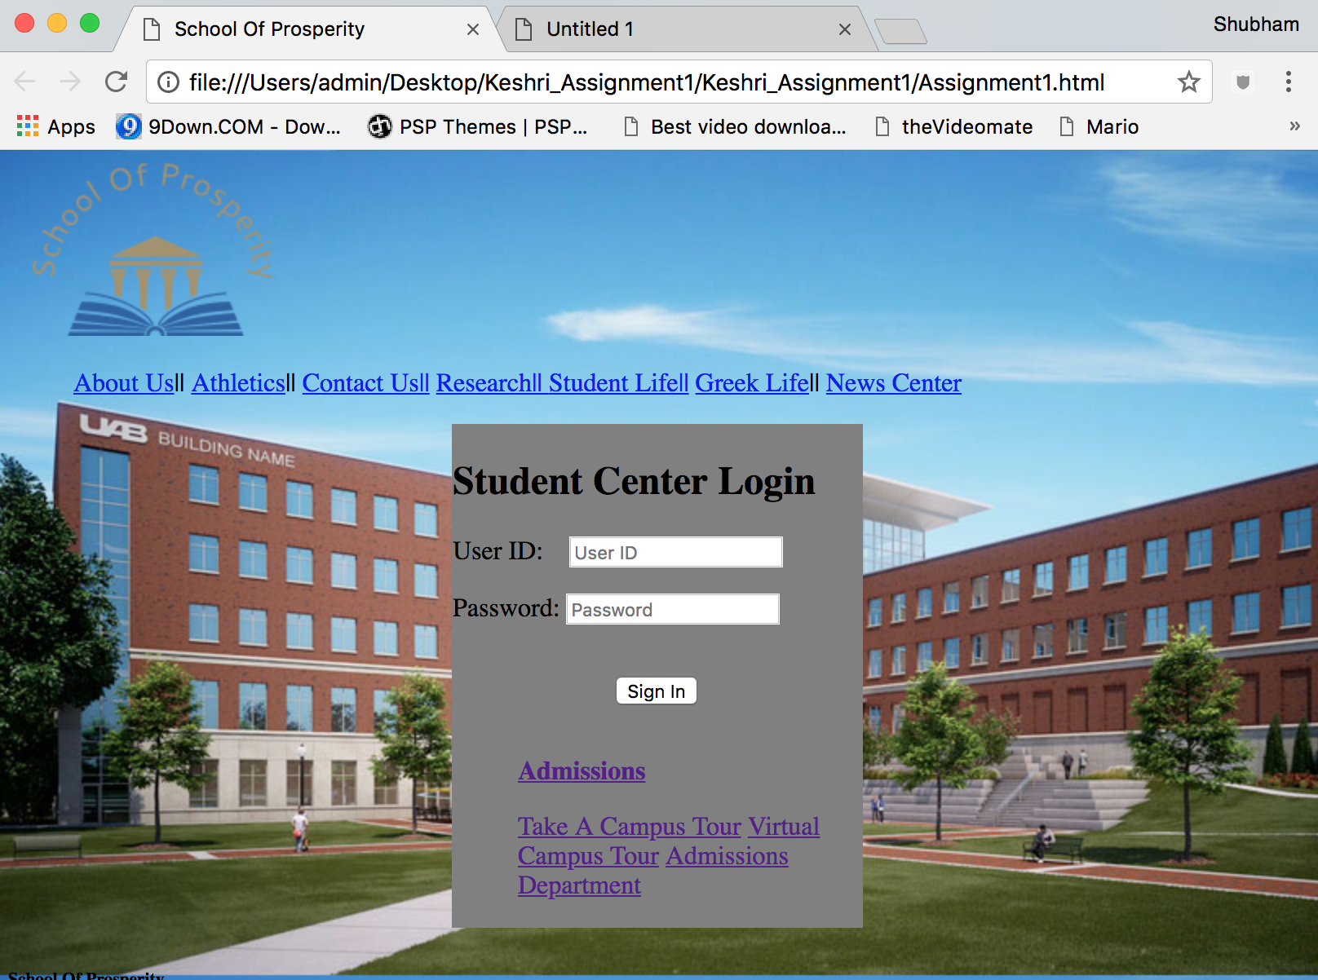
Website

Slide 42
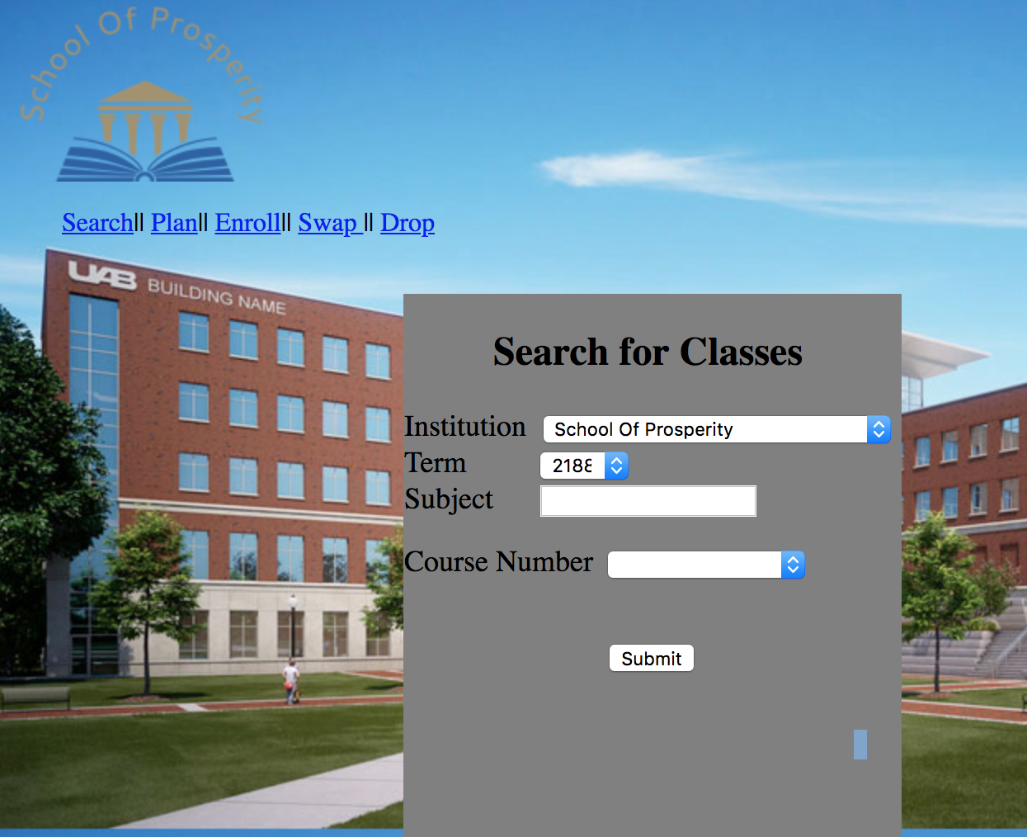
Website

Slide 43
Questions?

